Slide 1
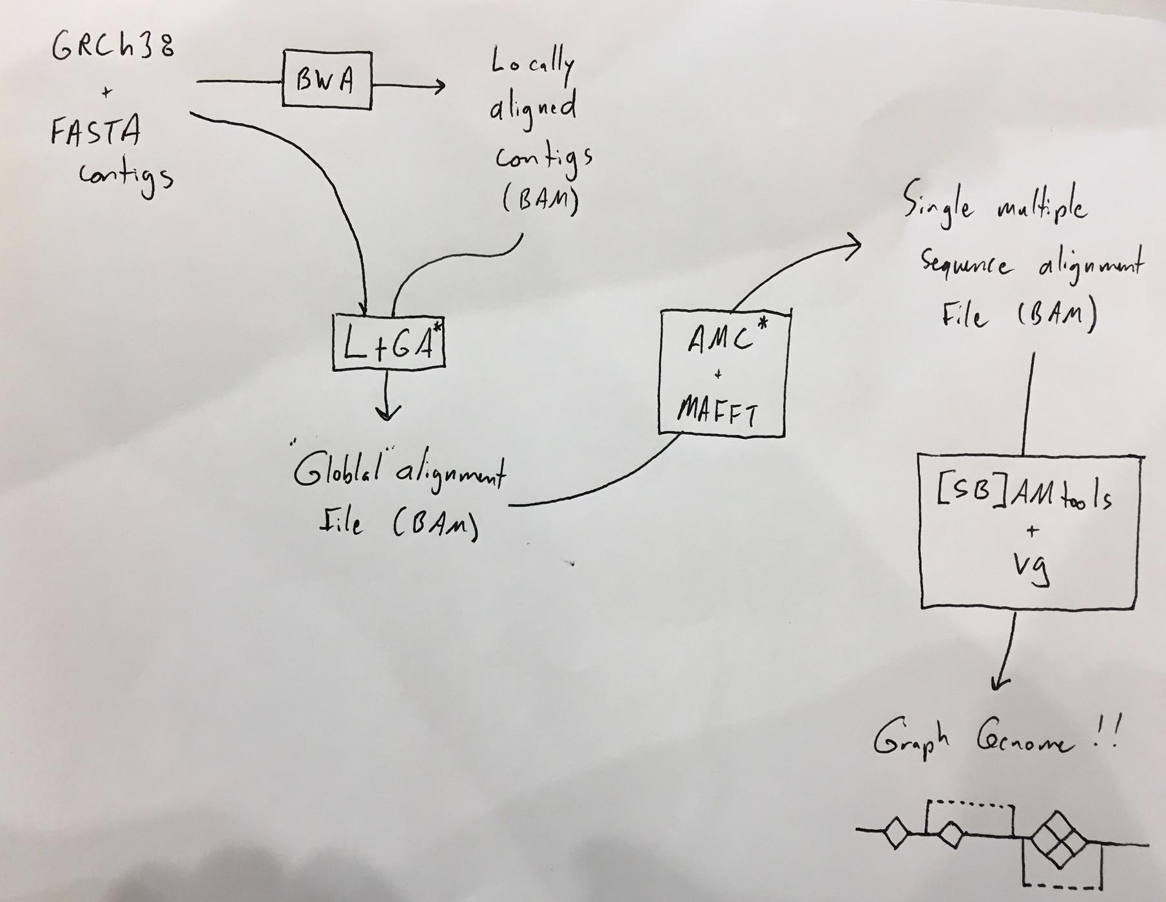
Whole genome graph creation from multiple assemblies

Slide 2
Whole genome graph creation from multiple assemblies
CSHL Graph Genome group

Slide 3
Steps: (1) Align all Contigs to GrCH38
Input:
FASTA files (contigs)
Reference FASTA (GRChr38)
Output:
BAM
Tools:
BWA

Slide 4
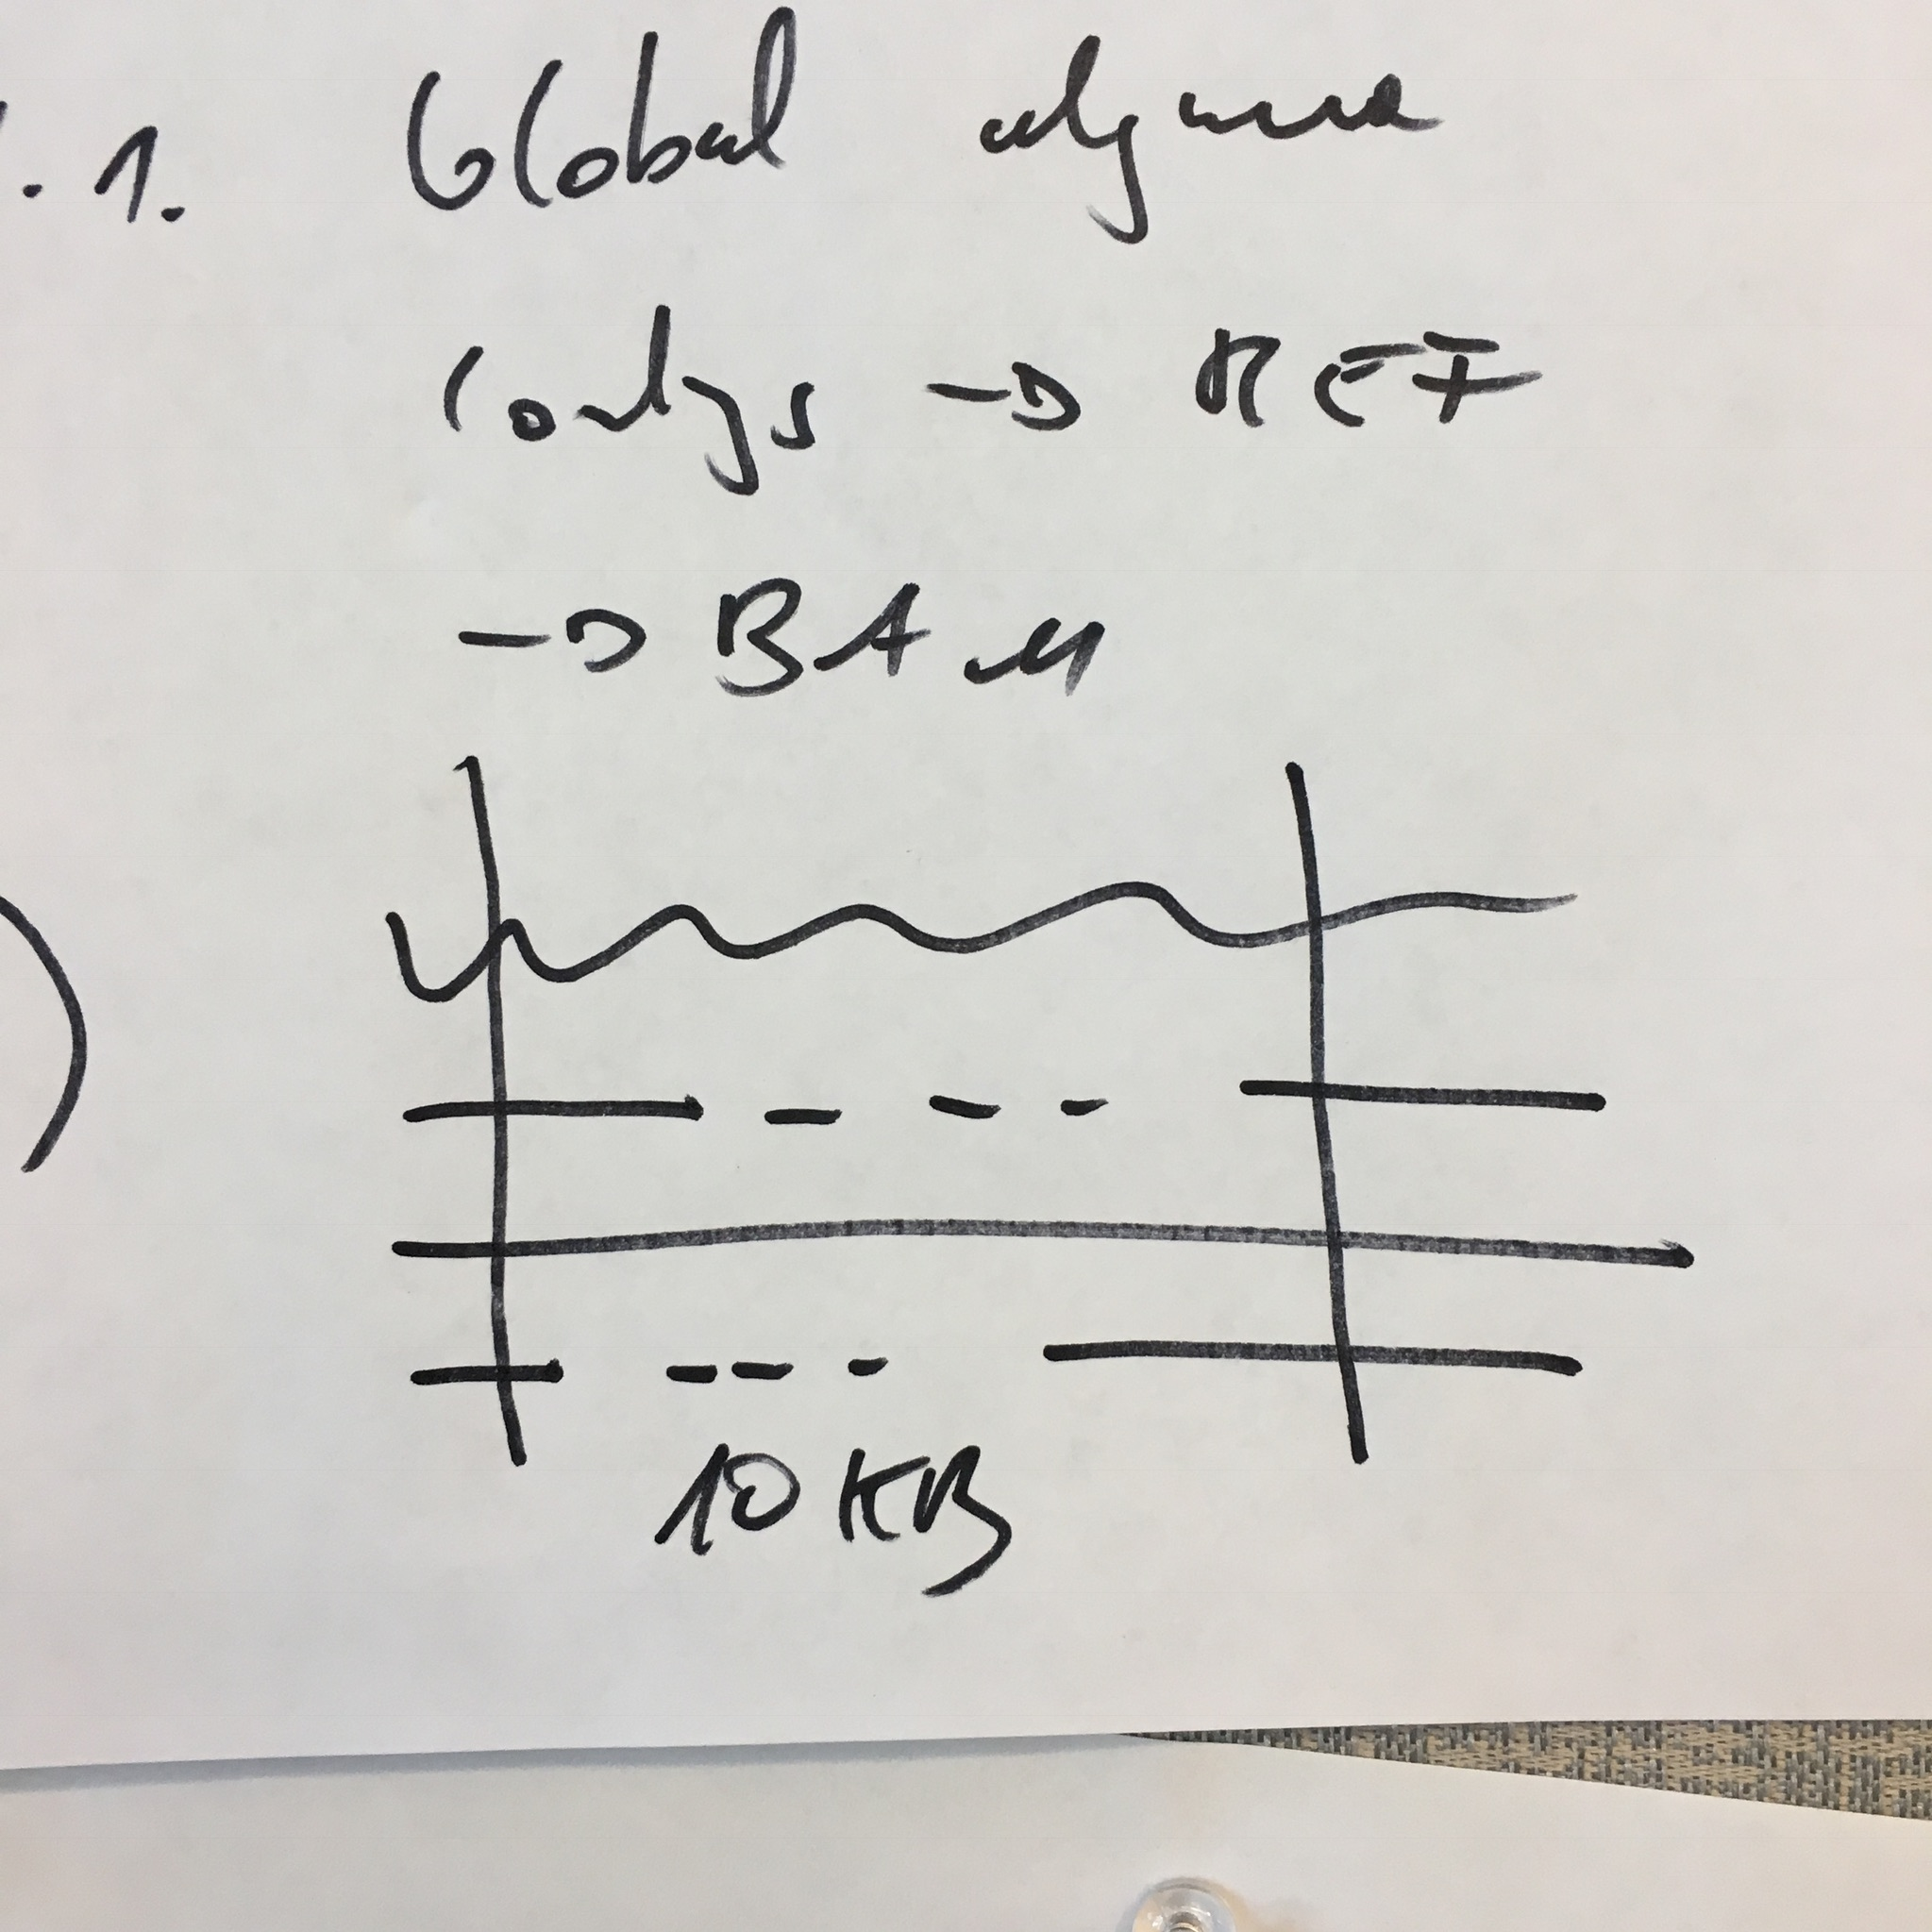
Steps: (1.1) Globally Align Contigs
Input:
FASTA files (contigs)
Reference FASTA (GRChr38)
BAM
Output: BAM?
each contig has single alignment
Tools: Local to Global Alignment

Slide 5
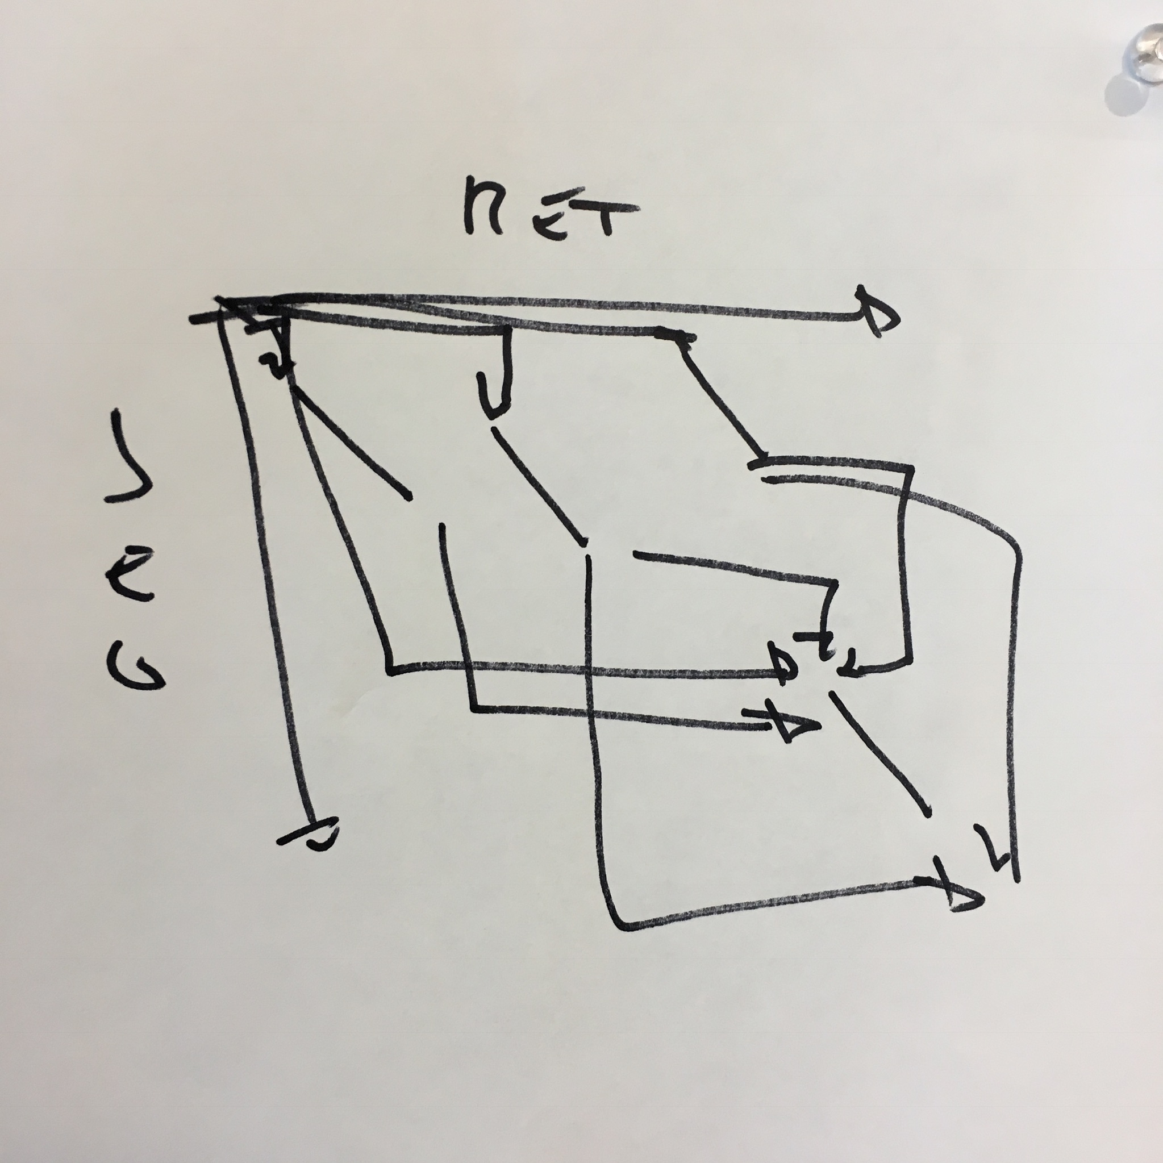
Steps: (2) Divide & Conquer MSA
Input:
BAM
Output:
BAM
Tools:
MAFFT (alignment)
Some C++ code (chopping & reassembling)

Slide 6
Steps: (2) Divide & Conquer MSA
Start with large concatenation of “local” alignments in a BAM file.
Use AMC? code to identify windows, excise each window, do multiple sequence alignments on each window, use AMC to re-assemble MAFFT into a single BAM. [file conversion between FASTA / MAFFT]

Slide 7
Steps: (3) Export
Input:
BAM
Output:
BAM, VCF, VG
Tools:
Vg
Other wrappers

